Slide 1
IMPORTANT INFORMATION
This presentation follows Aprio brand guidelines and uses the Lato font family.
Lato font is open source and free for both commercial and non-commercial use. Please download and install the font using the links below. Failure to do so may cause issues with the font displaying properly on this presentation.
Download Lato: https://www.latofonts.com/download/lato2ofl-zip/
Font Installation instructions: https://www.laptopmag.com/articles/install-manage-fonts-windows-10

Slide 2
Cyber Risks Impacting the Nonprofit Industry

Slide 3
Presenters
Brett Williams
Shane Peden
Kristina Brown
Risk Advisory and Assurance Services Leader
Managing Director, Information Assurance – PCI, CaaS, and Cybersecurity
Senior Manager | Cyber, Governance, Risk and Compliance

Slide 4
Agenda
Overview of Cyber, Governance, Risk and Compliance Services
Third-Party Risk Management
Data Privacy
Cybersecurity Awareness
Questions

Slide 5
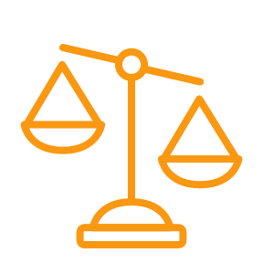
Cyber, Governance, Risk and Compliance Services
Identify, assess, and mitigate risk
Cybersecurity Services
Provide Security and Privacy reports and certifications
Penetration testing and vulnerability scanning
Technology due diligence
Cyber risk & maturity assessments
Cyber health check
Third-party risk management
NIST SP 800-171 and NIST SP 800-53 readiness and Independent Verification and Validation
Governance, Risk, and Compliance (GRC) Services
Provide services around the identification of risks, implementation of controls, and related recommendations
Assist with compliance efforts like Sarbanes-Oxley (SOX). A set of processes and procedures to help organizations achieve business objectives, handle uncertainty and act with integrity
Business process improvement and advisory
Internal Audit Services
Outsourcing and staff augmentation for business process and IT audits
Multi-year risk-based audit planning
Agile audit advisory
Cost-effective services through reliance on internal audit services
Identify and address critical risks and issues now and for the long-term

Slide 6
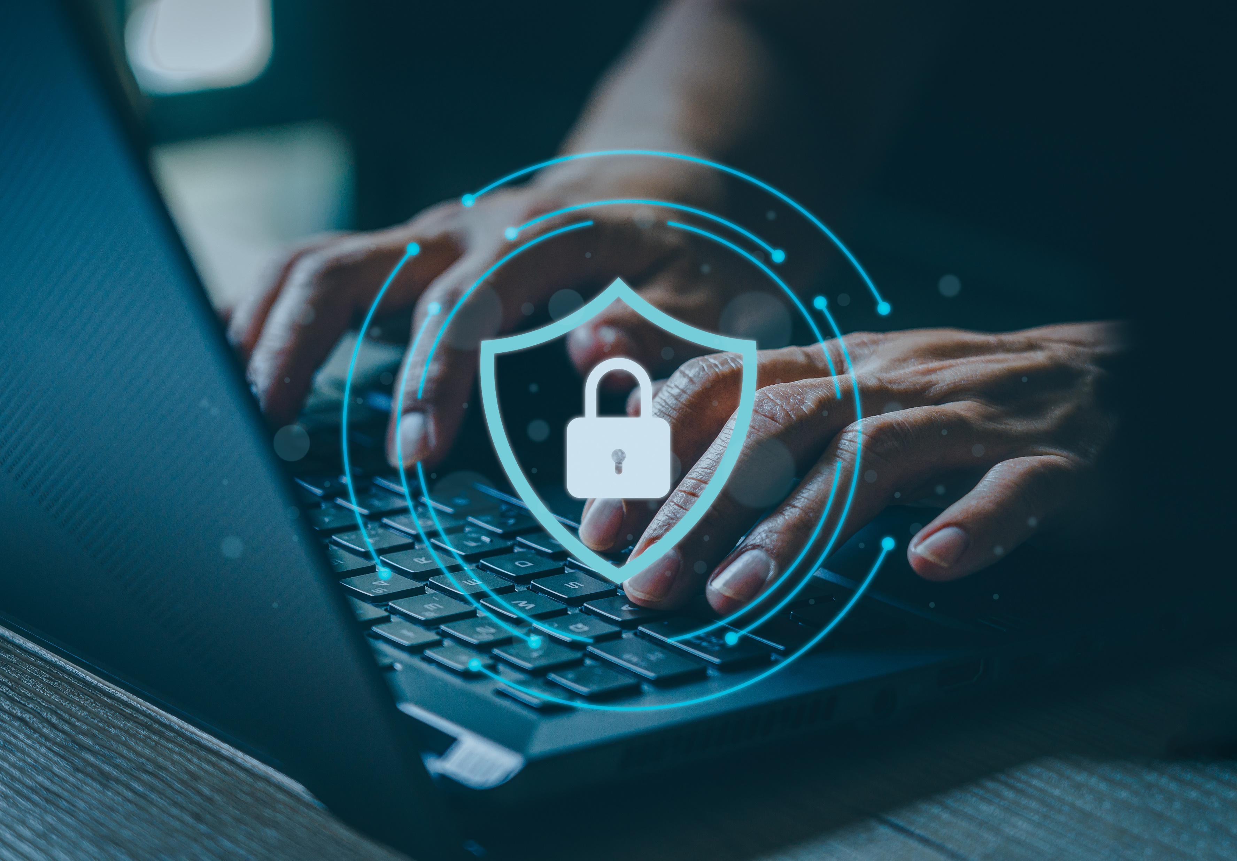
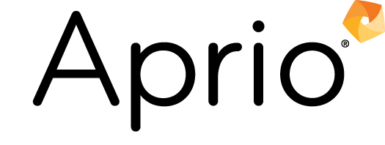
Third Party Risk Management

Slide 7
What is Third-Party Risk Management?
There is a growing dependence on third parties for companies across a diverse range of industries, including the nonprofit industry, which introduced significant new levels of risk to organizations. In order for organizations to continue to grow and advance, developing a level of trust with third parties remains critical.
TPRM
Third-party risk management (TPRM) is the process of identifying, assessing, and mitigating risks associated with engaging external third parties like vendors, suppliers, contractors and business partners.
Definition

Slide 8
TPRM Program Foundations
To manage third-party risks, it’s important to establish foundational components of a TPRM program.
Oversight and Governance
Defining a framework that define the groups that manage the TPRM program and the way the function operates within the organization.
Policies and Standards
Defining roles and responsibilities for TPRM activities written in policies, procedures, and standards and are accessible to the individuals responsible for these areas.
Third-Party Inventory
Developing a centrally located repository of third-parties that is available to all business owners and contains service-level information about the third parties.
Risk Models
Develop risk criteria based on the organization’s risk tolerance level that informs the TPRM program to assess, prioritize, and evaluate third parties
Assessment Methodology
Defining a process for which third-party risk is classified, ranked, and reported. The assessment includes obtaining third-party assessment reports and reporting findings to management.
Automation and Reporting
Utilizing technology and automation to automated and expedite the selection, onboarding, and monitoring third-party risks effectively.

Slide 9
Oversight and Governance
An important first step in managing third-party risk is to ensure that there are defined policies, procedures, and processes in place to procure and contract new vendors.
Third-party risk assessments should be built into the procurement process prior to contracting. This requires a centralized procurement process and detailed steps in order to ensure that the process is being followed.
A common breaking point in the TPRM process is that departments will procedure and contract with vendors without a known and formalized process that should be followed.

Slide 10
Third-Party Risk Assessments
As organizations increase their reliance on third-parties, the listing of third-parties can become lengthy. Organizations may choose to a risk-based third-party risk assessment approach based on the criticality of the third-party and the data that their sharing.
Organizations should seek to review their critical and high vendors on at least an annual basis by performing a review of their attestation or other audit report. If audit reports are not available, organizations should consider re-performing the vendor risk questionnaires.
By proactively assessing your third-parties, an organization will be able to make more informed decisions about renewals, data management, and potential risks.

Slide 11
Key Actions to Advance Your TPRM Function
To manage third-party risks, it’s important to establish foundational components of a TPRM program.
Identify third parties and build an inventory
Pre-Contract: Establish contract terms and perform due diligence prior to contracting Post-Contract: Review ongoing third-party risks through regular vendor reviews
Understand criticality and data sharing
Develop a third-party tier rating based on criticality to the organization, and what data is being shared with the third-party
Perform ongoing monitoring of third parties
Develop a process to monitor third and fourth parties with emphasis on the most critical third-parties. Seek third-party risk management tools that allow automated assessment in real-time.
Evaluate the TPRM program
Organizations should evaluate their current operating model to determine if it’s operating effectively and ensure that processes are carried out effectively.

Slide 12
Data Privacy
Notes:
What apps do the participants use to manage donor/member info?

Slide 13
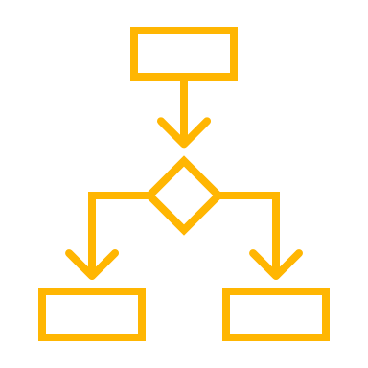
Important Data Privacy Terms
Data Privacy: The principle that a person should have control over their personal data, including proper handling through consent, notice, and regulatory obligations.
Data Processing: The collection and manipulation of data to produce information. This can include taking any action with data including recording it, keeping it, changing it, using it and deleting it.
Personally Identifiable Information (PII): Information that can be used to distinguish or traced and individual’s identity, either when alone or when combined with other information that is linked or linkable to a specific individual.
Protected Health Information (PHI): Any information in the medical record or designated record set that can be used to identify an individual and that was created, used, or disclosed in the course of providing a health care service such as diagnosis or treatment

Slide 14
The Core Principles of Data Protection
CONFIDENTIALITY
The protection of sensitive information from being accessed or disclosure by unauthorized
INTEGRITY
The protection of data from unauthorized modification or destruction
AVAILABILITY
The assurance of timeline and reliable access to data and systems by authorized users.
Notes:
Confidentiality
Ensure that data is only accessible to those authorized to view it.
Examples: Password protection, encryption, user authentication.
Integrity
Maintain the accuracy and consistency of data over its lifecycle.
Example: Data validation, checksums, and version controls.
Availability
Ensure data is available and accessible when needed, without interruptions.
Example: Backup systems, disaster recovery plans.

Slide 15
Data Privacy Laws
There are an increasing number of data privacy laws and regulations that organizations must comply with. Some of these include laws related to location such as General Data Protection Regulation (GDPR), California Consumer Privacy Act (CCPA), and the New York Privacy act where others relate to the specific industry such as the Health Insurance Portability and Accountability Act (HIPAA) and Family Educational Rights and Privacy Act (FERPA).
It’s important for organizations to know which laws and regulations may apply to them and ensure that there are proper controls in place to comply with the requirements.

Slide 16
Key Principles of GDPR
GDPR
Lawfulness, Fairness, and Transparency
Data Minimization
Purpose Limitation
Integrity and Confidentiality
Accuracy
Accountability
Storage Limitation
Notes:
Firstly, you need to process data Lawfully, Fairly and Transparently. The GDPR sets out a number of grounds on which you can process Personal Data lawfully, and we’ll come on to those in the next module – but in addition you can’t process data in a way that breaks any other laws.
You must process data Fairly ‘considering how the processing may affect the individuals concerned’ and being able to ‘justify any adverse impact’. This includes only processing Personal Data in ways people ‘would reasonably expect’ and if not being able to ‘explain why any unexpected processing is justified’, and more generally not to ‘deceive or mislead people’ when you collect their personal data.
And lastly you must be Transparent working in an open and honest way.
How might this work in practice? Let’s look at an example that we can use to explore these 7 principles in action. Say you wanted to collect Personal Data on learners’ gender identities in order to ensure transgender students progressed as well as cisgender. So, remember the principle is to process the data in a way that’s ‘Lawful, Fair and Transparent’. You’d need a lawful reason for doing so – we’ll explore this in a later module. You’d need not to be breaking any other laws. No issue there.
You’d then need to ‘consider how it might affect the individuals concerned’ and ‘justify any adverse impact’. It could be stressful being asked your gender identity and knowing this was recorded, in particular if this was information you hadn’t yet shared perhaps with friends, teachers or family members.
Here the principles don’t tell you the right answer, but they give you a framework within which to make a reasonable decision. Lastly, you’d need to be transparent, to be clear to the students concerned about why you’re collecting the data, and what you’d be using it for.
This leads on to the second principle – that Personal Data should be used for a specific purpose [/3]. In the example above, the specific purpose is to close opportunity gaps between transgender and cisgender learners.
What you can’t do is say, just gather Personal Data, with a vague idea you might use it later. You also can’t change your purpose significantly without getting the data subject’s consent to do so.
So, you know now why you’re processing the Personal Data, but how much do you need? This is the third principle, that Personal Data is ‘adequate’, ‘limited’ and ‘necessary’ or what you might call more colloquially ‘the Goldilocks principle’. You should process not too little data for your purpose, not too much, but the amount that’s just right.
If your purpose in our example were instead to narrow achievement gaps for all learners with a range of protected characteristics – for example race, gender, special educational need as well - it’s pretty clear that only collecting information on gender identity wouldn’t be sufficient. Nor could you collect information that wasn’t relevant at all to your stated purpose.
The fourth principle is ‘accuracy’. There’s an obligation to make sure that ‘Personal Data you hold is not incorrect or misleading’, that it’s kept updated if that’s required, that you take reasonable steps to address inaccurate data, and that you ‘consider any challenges to the accuracy of personal data’.
Apart from anything else, this is just good practice. You’ll be storing your Personal Data for a purpose and if it’s inaccurate or misleading you won’t be able to achieve that purpose when you use it. Continuing our example, if the Personal Data you hold on learners’ gender identities is incorrect the analysis will be meaningless.
The fifth principle is to ‘not keep data for longer than you need it’. So, if you collected that Personal Data on gender identity for a one-off piece of analysis you should delete it afterwards, if you planned to repeat the analysis it may be appropriate to keep it for a length of time. It’s also a good idea every now and then to review the Personal Data you hold and to ‘erase or anonymise it if it’s no longer needed’.
The sixth principle is that Personal Data is kept securely. This is a whole team effort, but in the Data Breaches module we’ll be discussing some ways you can help keep data secure in your organisation.
And lastly, there’s the principle of accountability that requires you to take responsibility for what you do with Personal Data and how you comply with the all other principles.
There’s a lot to take in there, so it’s worth spending a few minutes having a think about how this might apply to you in a real life situation.

Slide 17
User Rights and Obligations
Data subjects (a living person whose personal data is being collected, processed, or used) have various right, such as:
Right to access personal data
Right to rectify incorrect or outdated information
Right to erasure (right to be forgotten)
Right to object to data processing
Right to data portability (transfer personal data to another provider)
Similarly, employees have obligations to ensure that personal data is kept secure, such as:
Understand and respect the data privacy policies in place
Be vigilant about phishing, social engineering attempts, and other malicious activities
Report any suspected data privacy breaches immediately to the relevant authority within your organization

Slide 18
Artificial Intelligence and Data Privacy
Artificial Intelligence (AI) heavily relies upon large datasets, which include personal and sensitive information, to train the algorithms. The output of the AI tool is based upon the data inputs that have been provided. This may lead to the end users of AI relying and making decisions without transparency into the AI models.
AI algorithms are trained based upon user input. This may lead to lack of data quality and accuracy as the data is aggregated from various sources.

Slide 19
Using AI Intelligently
When using AI in your work or personal life, it’s important to consider the following:
Use AI as a guide, rather than a decision maker. AI can be a great tool to compile information and provide details, but should not be solely used to gather facts or make decisions as the data may not be accurate.
Do not share personal or organizational data with public AI tools. Once the data is shared, there is no way to get the data back and it will be added to the database supporting the algorithm.
Anonymize data that you are sharing. Mask or change names of individuals, companies, and locations in order to reduce the risk that personal or organizational data is leaked.

Slide 20
Best Practices for Data Protection
Data Collection
Collect only the data that you need for the specific purpose Inform individuals about what data you are collecting and how it will be used Ensure that consent is obtained where required
Data Storage
Store personal data securely, using encryption and access controls Regularly audit data store systems to ensure that protection mechanisms are up to date Set retention periods for data and delete data when it is no longer required
Data Sharing
Share personal data only when necessary and with only authorized parties Use contracts to define data-sharing agreements and ensure that data protection agreements are in place Ensure that secure transfer mechanisms for sharing data are in place and used.
Data Handling
Implement Role Based Access Control (RBAC) based on the principle of least privilege to restrict access to sensitive data Educate employees on handling personal data securely If required, ensure that applicable regulatory training is completed by all employees handling respective data
Data Breach Response
Establish a data breach response plan that includes detection, containment, and notification procedures Notify affected individuals and authorities within the required timeframe Regularly test and update the breach response plan

Slide 21
Cybersecurity Awareness
Notes:
What apps do the participants use to manage donor/member info?

Slide 22
Common Cyber Risks
The biggest cyber risk is people. Understanding common pitfalls can help protect your personal and your organization’s data.
Some common cyber attacks as defined below:
Phishing: A form of social engineering where attackers deceive people into revealing sensitive information or installing malware, such as viruses, worms, adware, or ransomware
Smishing: A formal of cyber attack that uses text messages to trick people into giving away personal information that appears to be from a trusted source
Ransomware: A type of malicious software designed to block access to a computer system until a sum of money is paid
Malware: Malicious software that can compromise a system’s data, applications, or operating system.

Slide 23
Phishing
Inspecting emails and links can help protect against phishing attempts.
Determining if a link is safe can be done in 4 easy steps:
Verify
Hover
Were you expecting a link?
Is the link from a trusted source?
Hover over the link to ensure that it leads to where it says it does
Sniff
Test
Click
Is it a site you recognize?
Does it feel “familiar”?
Always be skeptical
If it passes all the other test, click
When in doubt, throw it out

Slide 24
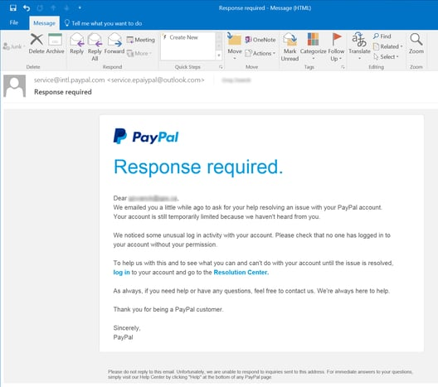
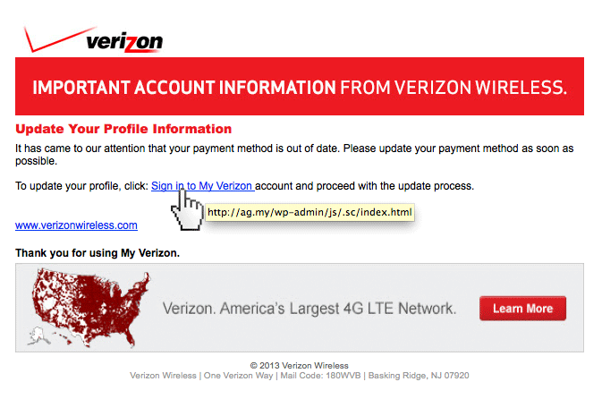
Phishing Examples

Slide 25
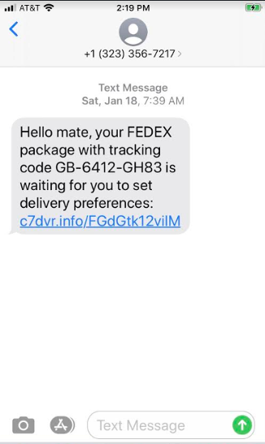
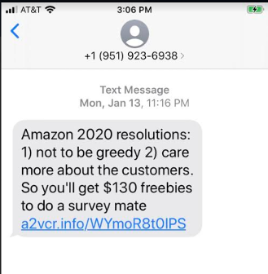
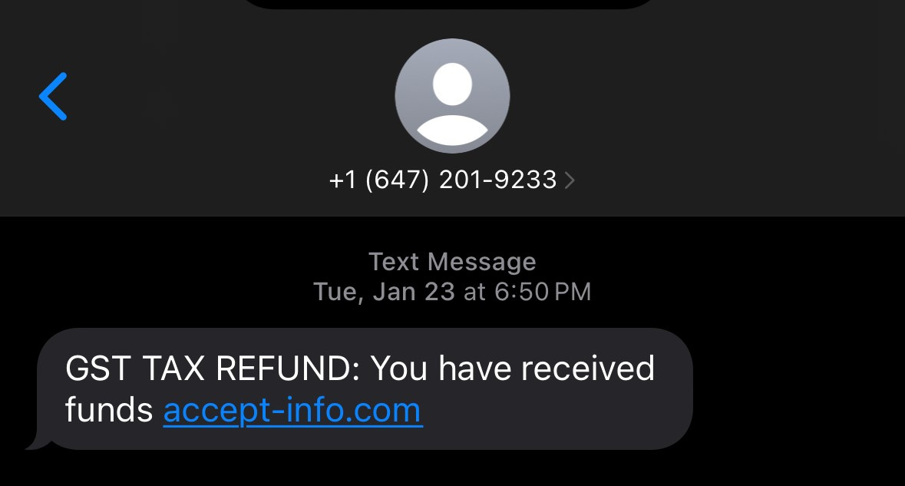
Smishing
Similar to emails, the use of cellphones has increased the risk of smishing. You may have seen these attempts in the past and sometimes they can be harder to verify. Here are some ways to identify a smishing attempt:
Do you recognize the number?
Are you expecting a text message?
Long hold to preview the link
Check for spelling errors
Never give anyone that’s not verified your multi-factor authentication code
Do not login from a questionable source

Slide 26
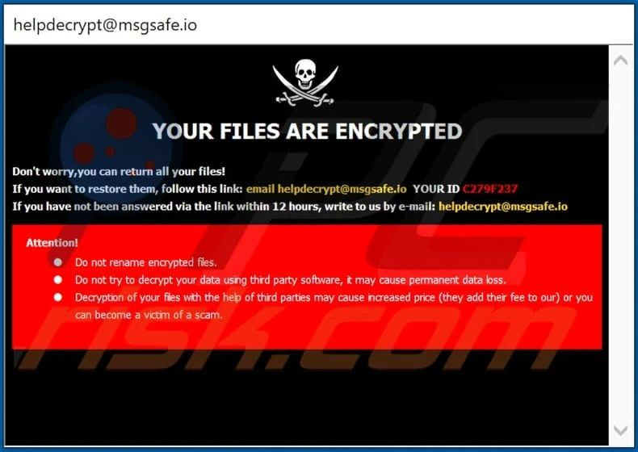
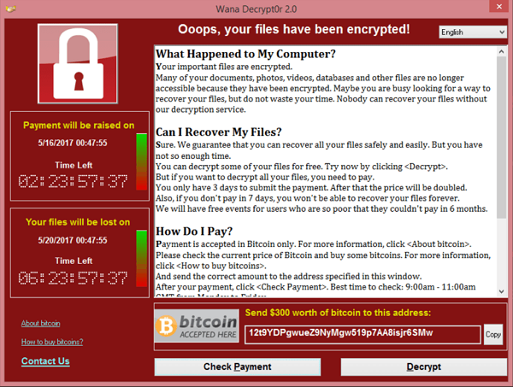
Ransomware
Attacks may gain access to your computer and install ransomware, which will shut down access to the environment until the ransom is paid.
If this occurs, contact your IT department immediately. Do not pay the ransom yourself.

Slide 27
Malware
Malware can be any type of malicious software that can impact your system. Signs of malware can include any of the following:
Unexpected pop-ups
Computer crashes
Slow performance
Unexpected messaged
Browser changes
Unresponsive device
Disabled security systems
If you notice these issues, contact your IT department.

Slide 28
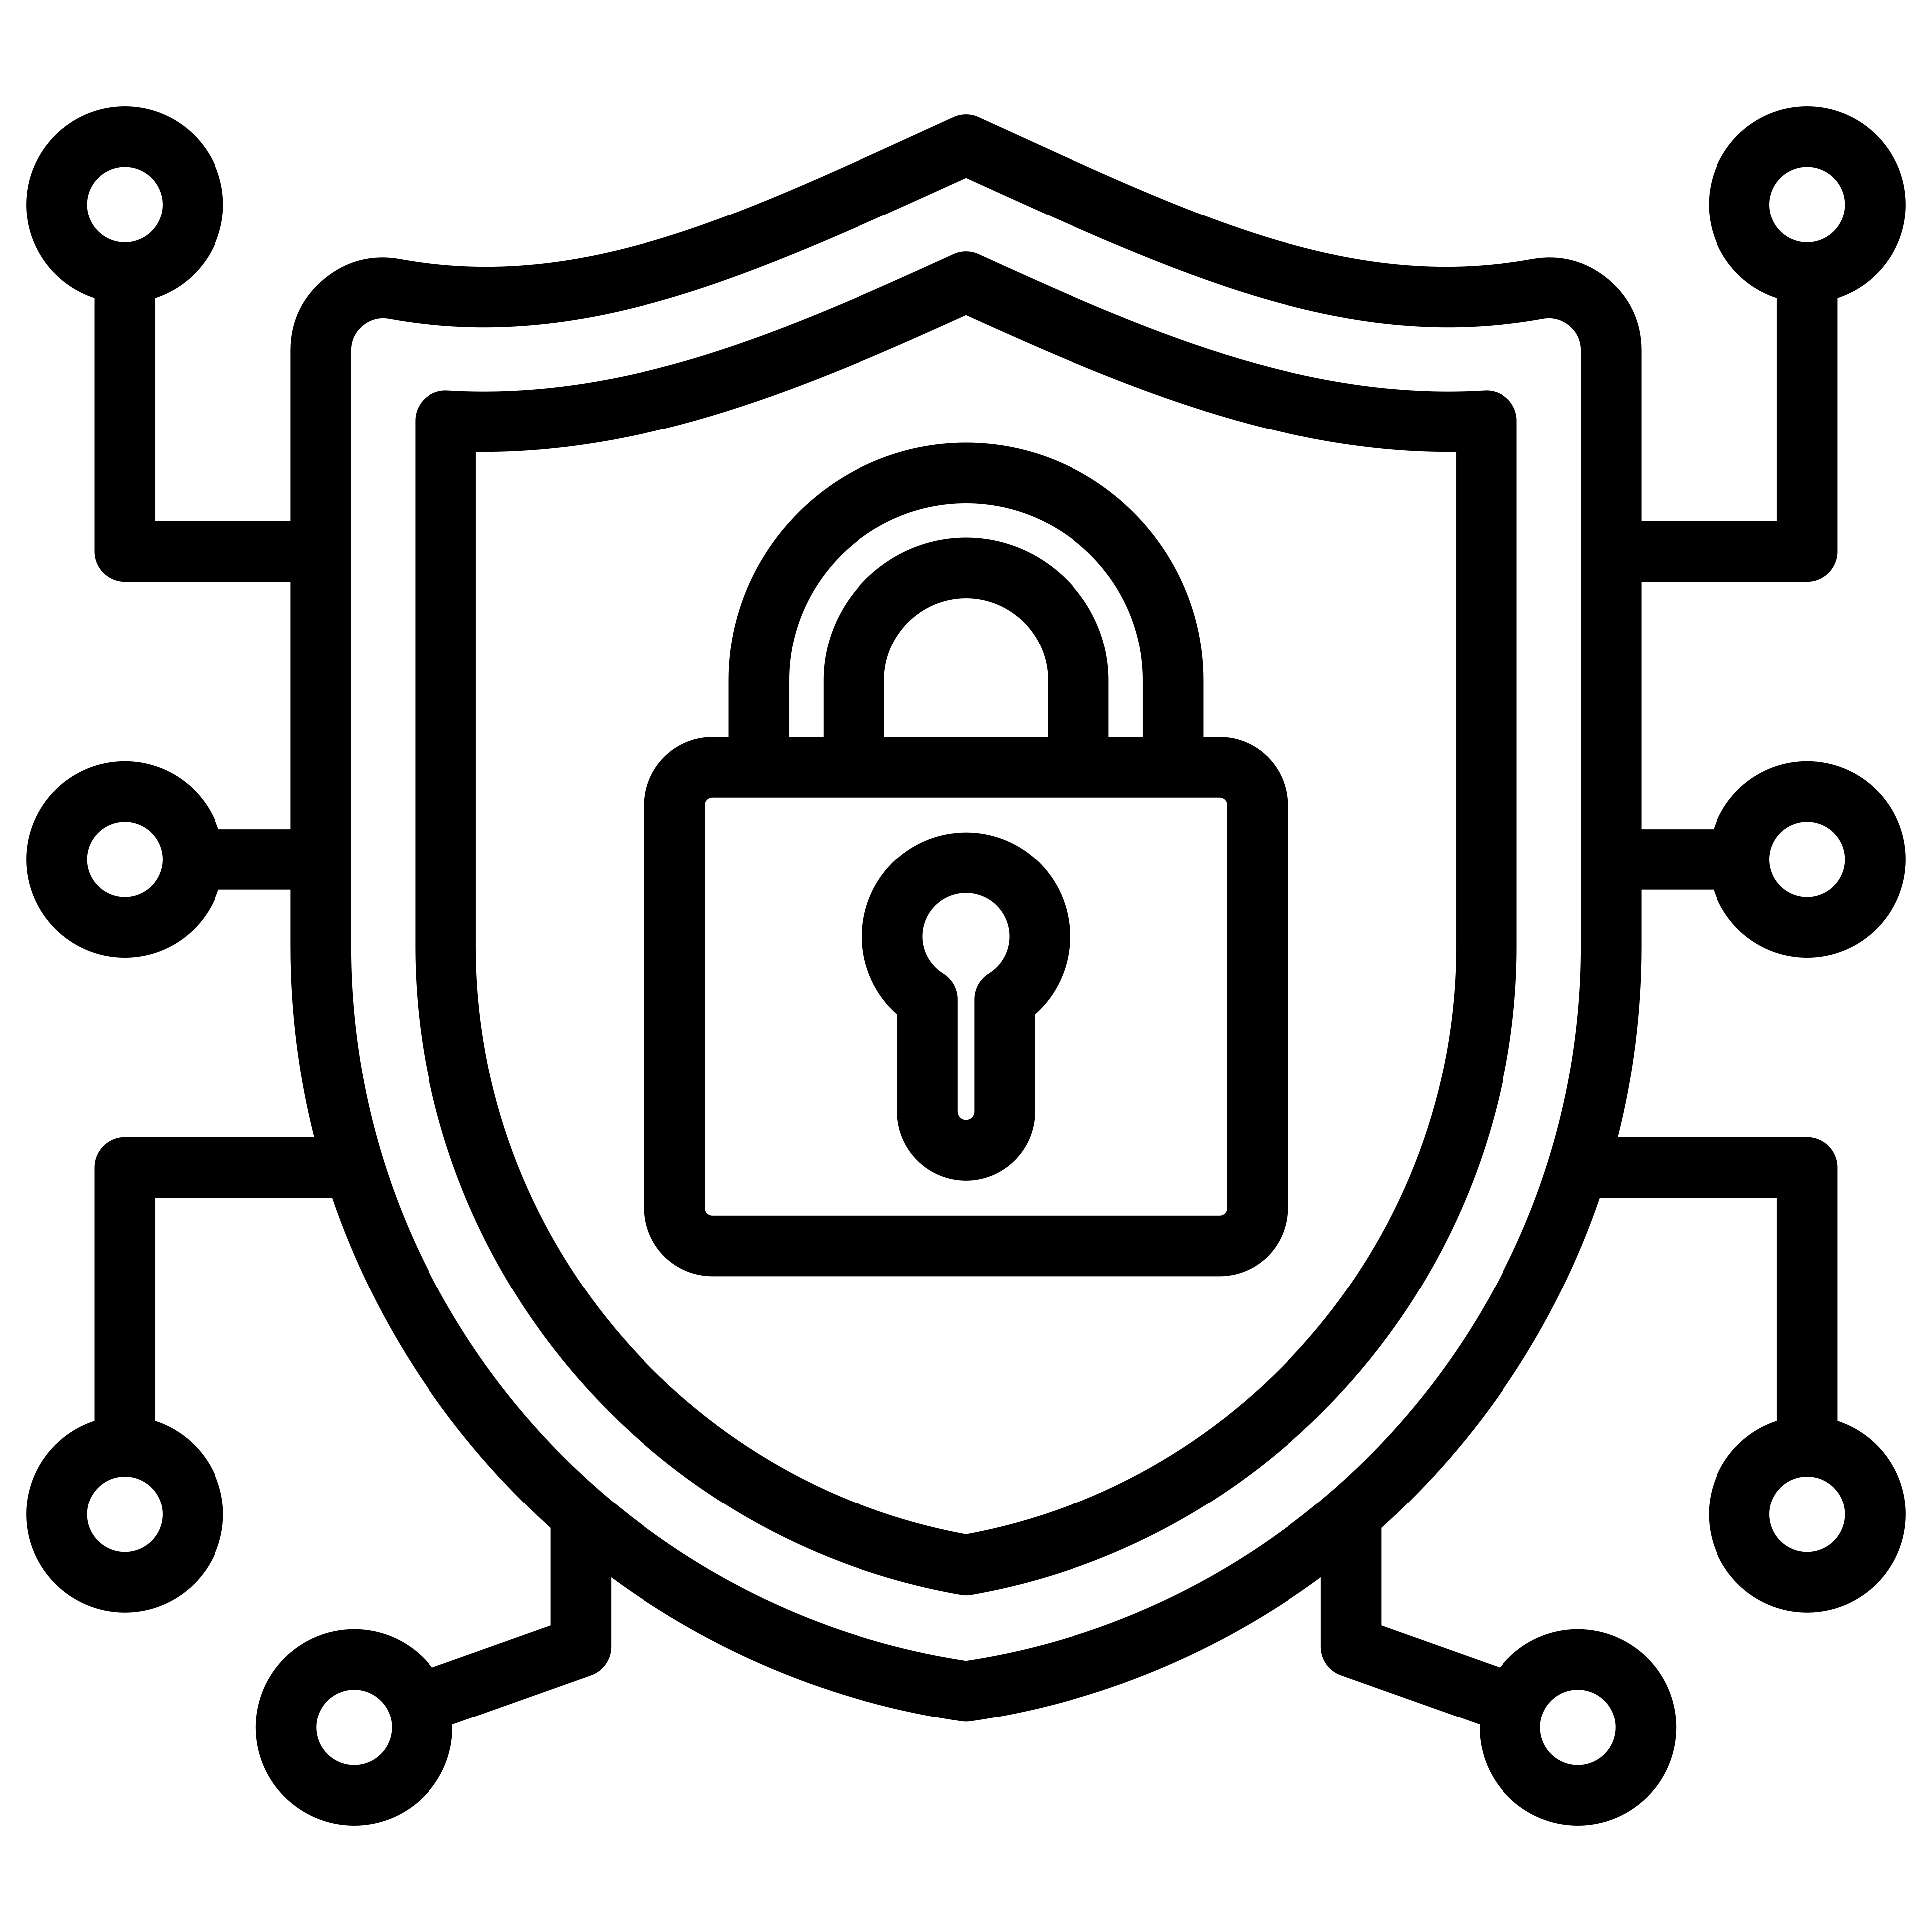
Importance of Passwords
Ensuring your have strong and protected passwords goes a long way in ensuring your data and environment remains secure. Here are some quick password tips to ensure your passwords remain safe:
Keep your passwords in a secure location – do not store them in clear-text or write them down
Avoid using things that can be associated with you: address, names, phone numbers, birthdays, sport teams
Use separate passwords for every account
Use passphrases that are not easy to guess:
At least 12 characters
Length is better than complexity
Use auto-generated passwords from a password safe where possible.
Use auto-generated passwords from a password safe where possible

Slide 29
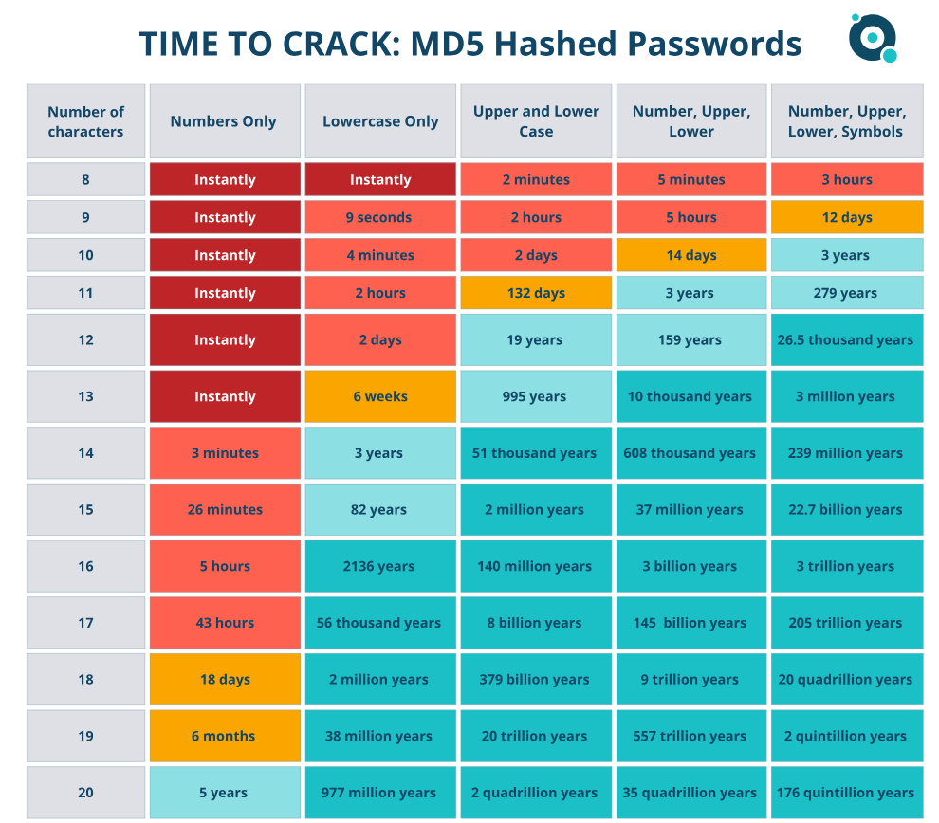
Importance of Passwords

Slide 30
Payment Fraud
Payment fraud is continuing to rise through the use of someone else’s financial information such as credit cards, bank accounts, and wire payments.
Payment fraud can be caused through phishing, data breaches, customized passwords, or providing information to malicious actors.
Ensure that you use secure payment platforms and keep your software up to date. Always be skeptical when providing payment information to unknown sources and never wire money without verifying the receiver’s information directly.

Slide 31
Questions?

Slide 32
Thank you!
Reach out to us with your questions at any time.
Brett Williams
Shane Peden
Kristina Brown
Risk Advisory and Assurance Services Leader
Managing Director, Information Assurance – PCI, CaaS, and Cybersecurity
Senior Manager | Cyber, Governance, Risk and Compliance

